Slide 1


BendFields: Regularized Curvature Fields from Rough Concept Sketches
Emmanuel Iarussi¹ David Bommes^{1,2} Adrien Bousseau¹
ACM Transactions on Graphics
1
2

Slide 2
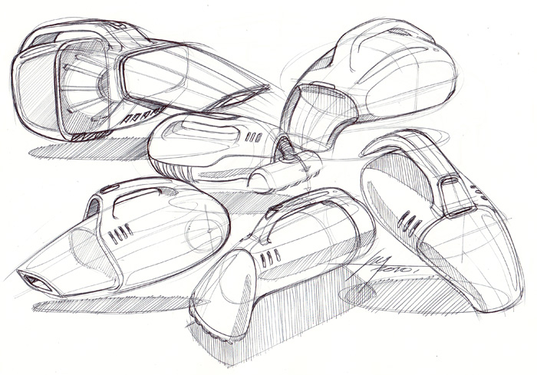
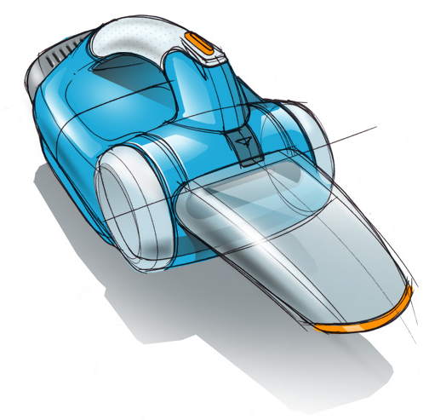
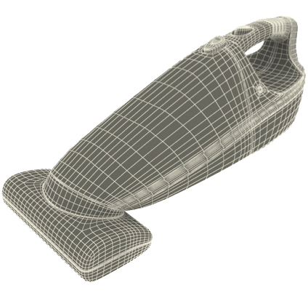
Sketches in design
Rough line drawings
Shaded drawings
3D models
© Spencer Nugent on sketch-a-day.com, © 3d_molier, turbosquid.com
© Spencer Nugent on sketch-a-day.com, © 3d_molier, turbosquid.com
Notes:
the rough line drawings are made of overlapping strokes drawn quickly", "the shaded drawing convey the appearance of materials

Slide 3
Sketches in design
Rough line drawings
Exploration
Rapid, flexible
Shaded drawings
Presentation
Takes time and expertise
3D models
Engineering
Takes time and precision
© Spencer Nugent on sketch-a-day.com, © 3d_molier, turbosquid.com
Notes:
Rough line drawings are rapid and flexible, what makes them perfect for shape exploration

Slide 4
Sketches in design
Rough line drawings
Exploration
Rapid, flexible
Shaded drawings
Presentation
Takes time and expertise
3D models
Engineering
Takes time and precision
© Spencer Nugent on sketch-a-day.com, © 3d_molier, turbosquid.com
Notes:
More polished shaded drawings are used to communicate with others and presentation.
The SHADED DRAWING CONVEY THE APPEARANCE OF MATERIASL
However, to render them is a time consuming task which requires skills.

Slide 5
Sketches in design
Rough line drawings
Exploration
Rapid, flexible
Shaded drawings
Presentation
Takes time and expertise
3D models
Engineering
Takes time and precision
© Spencer Nugent on sketch-a-day.com, © 3d_molier, turbosquid.com
Notes:
3D MODELLING REQUIRES PRECISION TO MANIPULATE 3D SHAPES ON SCREEN

Slide 6
Sketch-based modeling
Rough line drawings
Exploration
Rapid, flexible
Shaded drawings
Presentation
Takes time and expertise
3D models
Engineering
Takes time and precision
© Spencer Nugent on sketch-a-day.com, © 3d_molier, turbosquid.com
Notes:
The goal in sketch-based modeling is to simplify the transition between the first category, and the other 2.
More precisely, in our work we want to facilitate the rendering of shaded drawing from rough line drawing inputs.

Slide 7
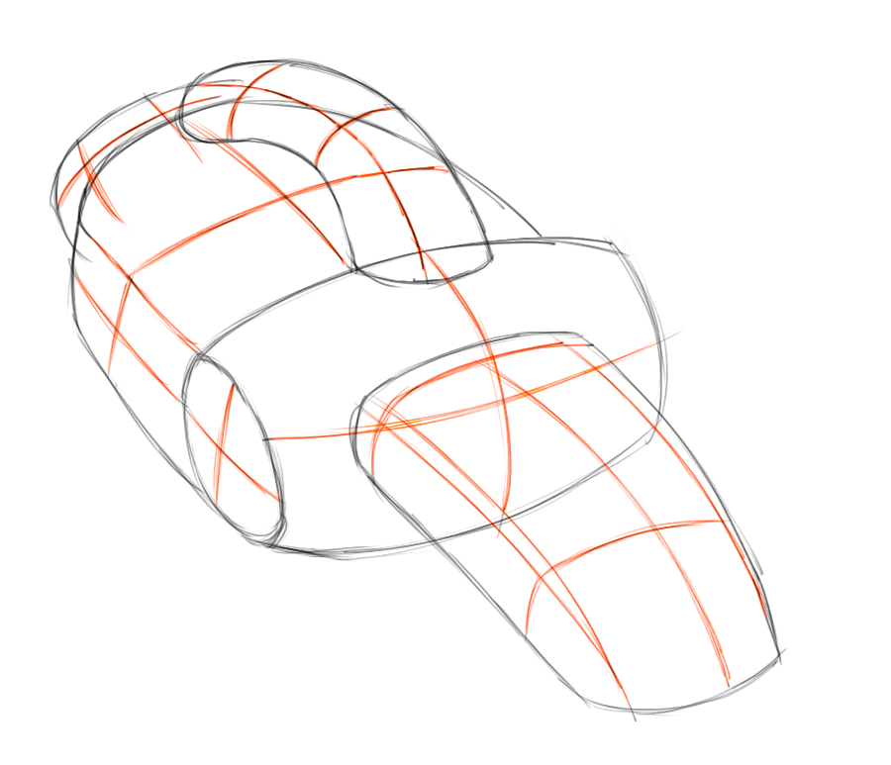
Our goal: normals from rough sketches

Slide 8
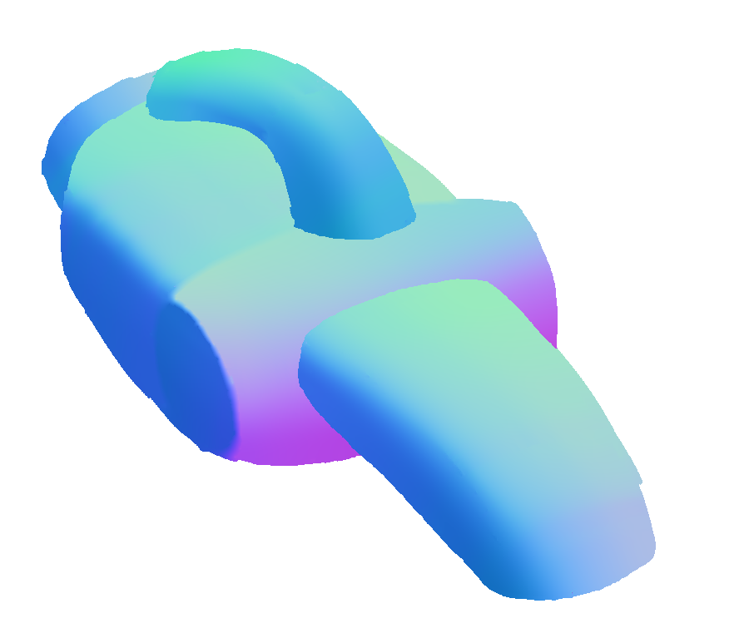
Our goal: normals from rough sketches

Slide 9
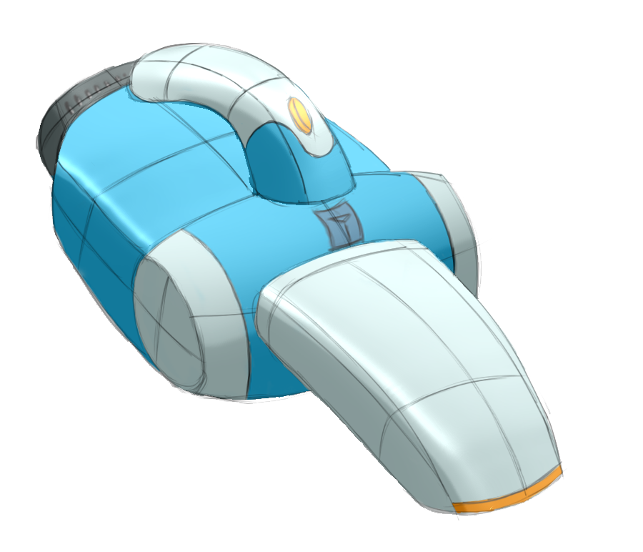
Our goal: normals from rough sketches

Slide 10
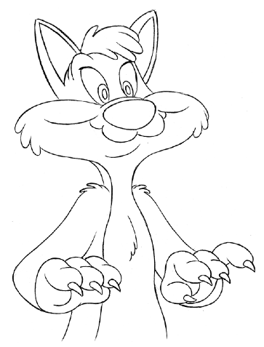
Lumo: Normals from silhouettes [Johnston 2002]
Along silhouettes, 2D normals coincide with surface normals
Notes:
Previous work, like lumo, exploited the fact that along silhouettes, 2D normals coincide with the surface normals, which can be diffused to inflate the shape.
But this inflation can only work for particularly set of bloby shapes,

Slide 11
Lumo: Normals from silhouettes [Johnston 2002]
Along silhouettes, 2D normals coincide with surface normals
Notes:
Previous work, like lumo, exploited the fact that along silhouettes, 2D normals coincide with the surface normals, which can be diffused to inflate the shape.
But this inflation can only work for particularly set of bloby shapes,

Slide 12
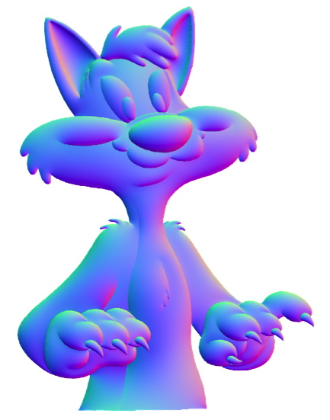
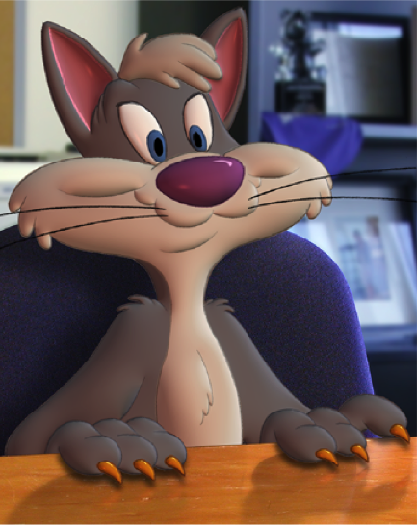
Lumo: Normals from silhouettes [Johnston 2002]
Along silhouettes, 2D normals coincide with surface normals
Diffuse to inflate the shape
Notes:
Previous work, like lumo, exploited the fact that along silhouettes, 2D normals coincide with the surface normals, which can be diffused to inflate the shape.
But this inflation can only work for particularly set of bloby shapes,

Slide 13
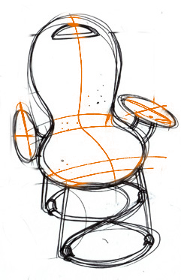
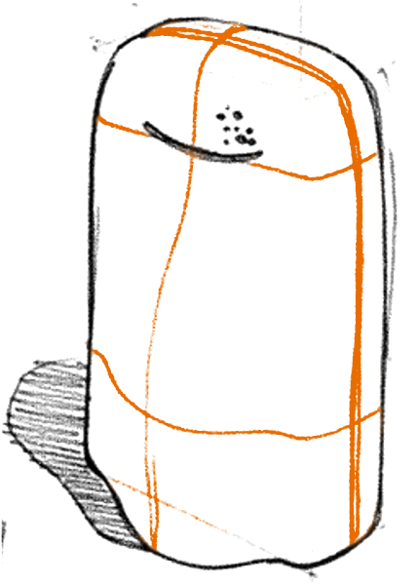
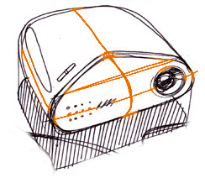
Cross-sections convey
curvature directions
© Spencer Nugent on sketch-a-day.com, © [Eissen and Steur 2011]
Notes:
THANKS TO CROSS SECTIONS, WE CAN PERCEIVE THE BUMP ON THE RIGHT
THE SILHOUETTE IS NOT ENOUGH TO DEPIC SUCH SURFACES
Another direction is what’s presented by crosshade 2012, where the authors exploit a particular set of lines used by desginers to convey shape.
This lines are called cross-sections an convey curvature directions allong the shape.

Slide 14
Cross-sections convey
curvature directions
Bump!
© Spencer Nugent on sketch-a-day.com, © [Eissen and Steur 2011]
Notes:
THANKS TO CROSS SECTIONS, WE CAN PERCEIVE THE BUMP ON THE RIGHT
THE SILHOUETTE IS NOT ENOUGH TO DEPIC SUCH SURFACES
Another direction is what’s presented by crosshade 2012, where the authors exploit a particular set of lines used by desginers to convey shape.
This lines are called cross-sections an convey curvature directions allong the shape.

Slide 15
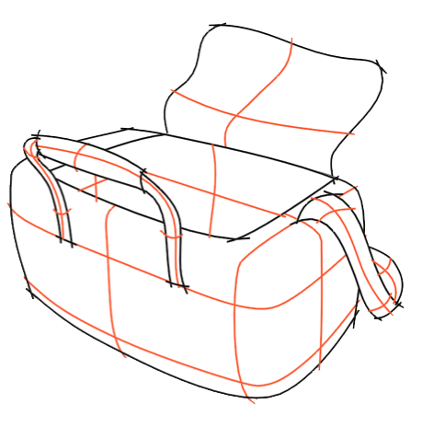
CrossShade: Normals from cross-sections [Shao et al. 2012]
Cross-sections convey curvature directions
Notes:
Since cross sections follow curvature lines, the athors could compute a 3D normal under the asumption of 3D orthogonality in 3D.
They then used coons to interpolate between curves.

Slide 16
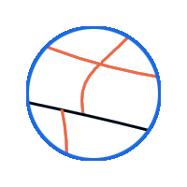
CrossShade: Normals from cross-sections [Shao et al. 2012]
Cross-sections convey curvature directions
Notes:
Since cross sections follow curvature lines, the athors could compute a 3D normal under the asumption of 3D orthogonality in 3D.
They then used coons to interpolate between curves.

Slide 17
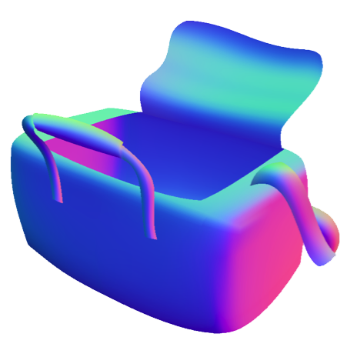
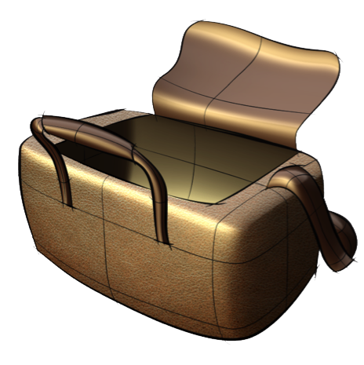
CrossShade: Normals from cross-sections [Shao et al. 2012]
Cross-sections convey curvature directions
Interpolate between curves using Coons
Notes:
Since cross sections follow curvature lines, the athors could compute a 3D normal under the asumption of 3D orthogonality in 3D.
They then used coons to interpolate between curves.

Slide 18
Limitation of prior work
Require clean vector curves as input
Notes:
In general, sketches used by artist and designers to quickly explore shape are rough bitmaps.
Crossshade approach requires clean vector input in order to cmpute the normals at intersections, and to do the interpolation using coons.

Slide 19
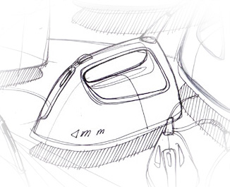
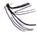
Limitation of prior work
Require clean vector curves as input
Many sketches are rough bitmaps
Notes:
In general, sketches used by artist and designers to quickly explore shape are rough bitmaps.
Crossshade approach requires clean vector input in order to cmpute the normals at intersections, and to do the interpolation using coons.

Slide 20
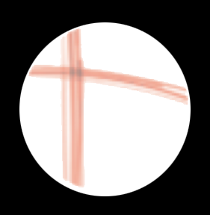
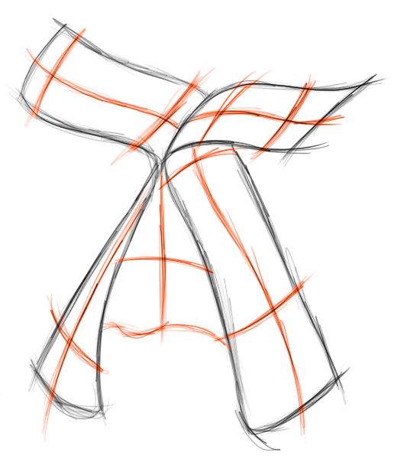
Our solution: propagate curvature directions from rough strokes
Input bitmap, local directions
Notes:
BYPASS
We propose to locally estimate 2D directions that we propagate in 2D to form a cross field.
Once we have crosses for each pixel, we can lift them to 3D by imposing orthogonality constraint

Slide 21
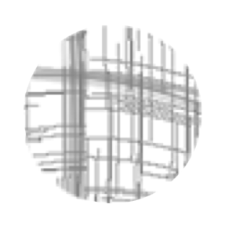
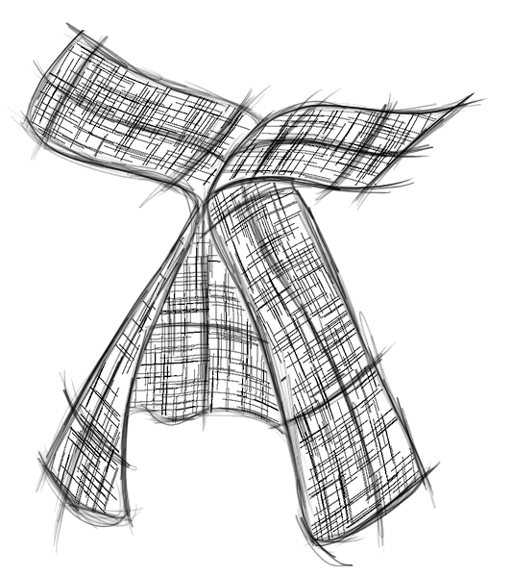
Our solution: propagate curvature directions from rough strokes
Propagate in 2D
Input bitmap, local directions
2 directions at each pixel to form a cross field
Notes:
BYPASS
We propose to locally estimate 2D directions that we propagate in 2D to form a cross field.
Once we have crosses for each pixel, we can lift them to 3D by imposing orthogonality constraint

Slide 22
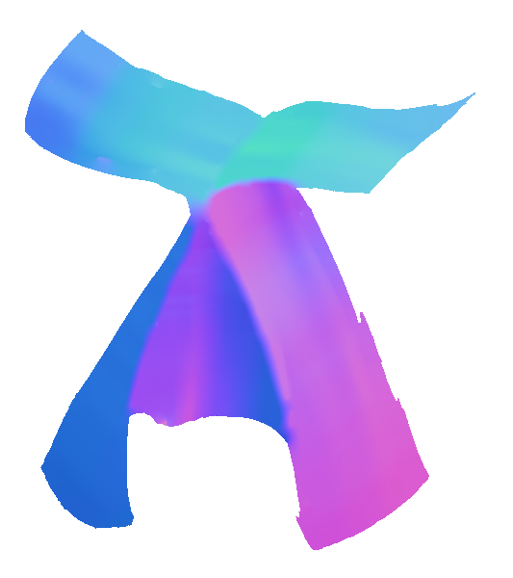
Our solution: propagate curvature directions from rough strokes
Propagate in 2D
Lift to 3D
Input bitmap, local directions
2 directions at each pixel to form a cross field
Normal at each pixel from orthogonality constraint
Notes:
BYPASS
We propose to locally estimate 2D directions that we propagate in 2D to form a cross field.
Once we have crosses for each pixel, we can lift them to 3D by imposing orthogonality constraint

Slide 23
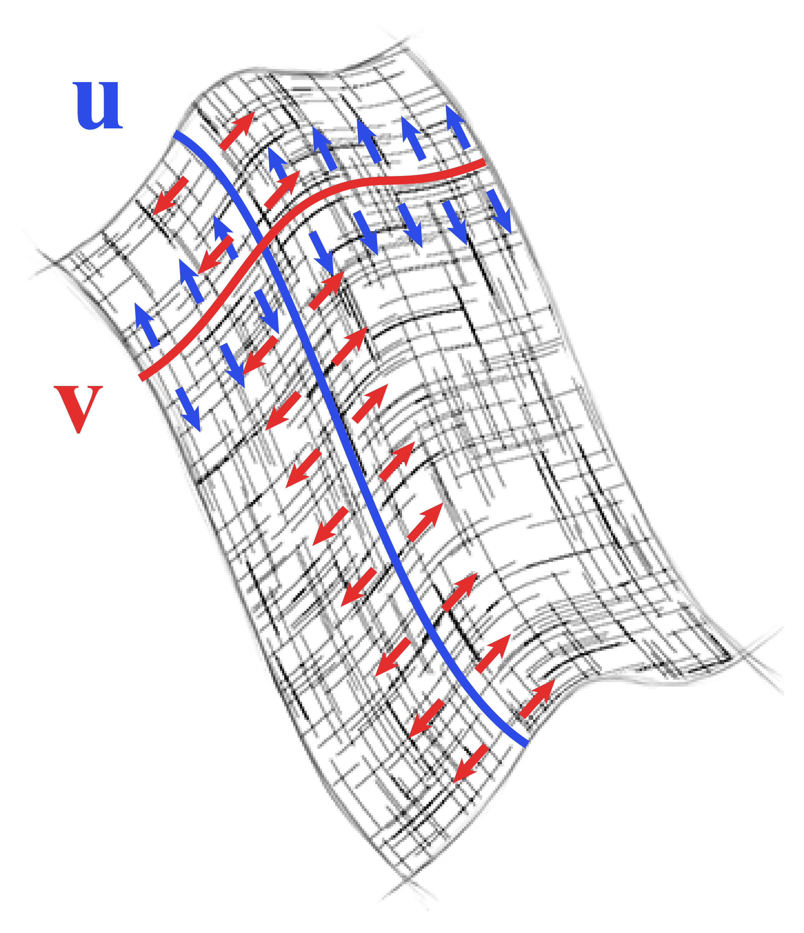


Main challenges
1
The BendFields smoothness energy
Non-orthogonal cross field
- Representation
- Optimization
2
-
Notes:
The 2 main challenges are to smoothly generate the cross field (that we call BendFields)
And the representation and optimization algorithm that we use for this task.

Slide 24
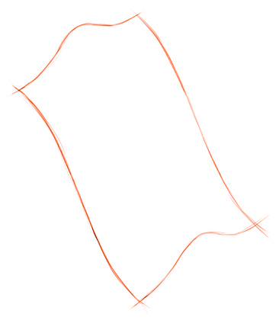
How to propagate curvature directions?
?
Notes:
Given an input sketch, with only directions defined for some pixels, we would like to propagate these directions on the empty pixels.

Slide 25
As smooth as possible (diffusion)
Notes:
WE ASSUME FOR NOW THAT WE KNOW WHICH DIRECTION IS CONSTRAINED BY EACH STROKE
A well known solution for smooth propagation problem is whats called diffusion, which, in our context would try to minimice the diference between all the neighbours of a pixel.

Slide 26
As smooth as possible (diffusion)
Notes:
A well known solution for smooth propagation problem is whats called diffusion, which, in our context would try to minimice the diference between all the neighbours of a pixel.

Slide 27
As smooth as possible (diffusion)
Notes:
A well known solution for smooth propagation problem is whats called diffusion, which, in our context would try to minimice the diference between all the neighbours of a pixel.

Slide 28
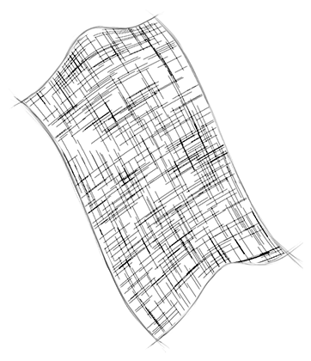
As smooth as possible (diffusion)
Notes:
However, diffusing the directions would lead to

Slide 29
As smooth as possible (diffusion)
Flat
Notes:
A flat configuration far from the constraints.

Slide 30
Interpolate opposite sides (Coons)
Notes:
As shown in previous work, we would like to generate results similar to coons patches, that interpolate opposite sides.

Slide 31
Interpolate opposite sides (Coons)
Notes:
As shown in previous work, we would like to generate results similar to coons patches, that interpolate opposite sides.

Slide 32
Interpolate opposite sides (Coons)
Notes:
As shown in previous work, we would like to generate results similar to coons patches, that interpolate opposite sides.

Slide 33
Interpolate opposite sides (Coons)
?
We don’t know
which lines form
opposite sides!!
?
?
?
Notes:
As shown in previous work, we would like to generate results similar to coons patches, that interpolate opposite sides.

Slide 34
Our solution: smooth each direction along the other direction
Notes:
Instead, we would like to make each direction smooth along the other and viceversa

Slide 35
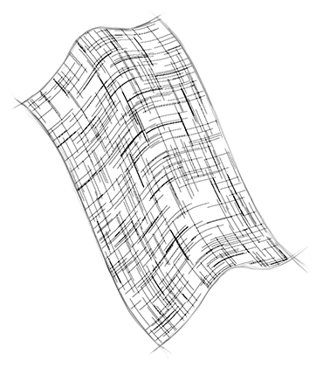
Our solution: smooth each direction along the other direction
Notes:
Using this restriction, we obtain a behaviour much more similar to what coons patches generates.

Slide 36
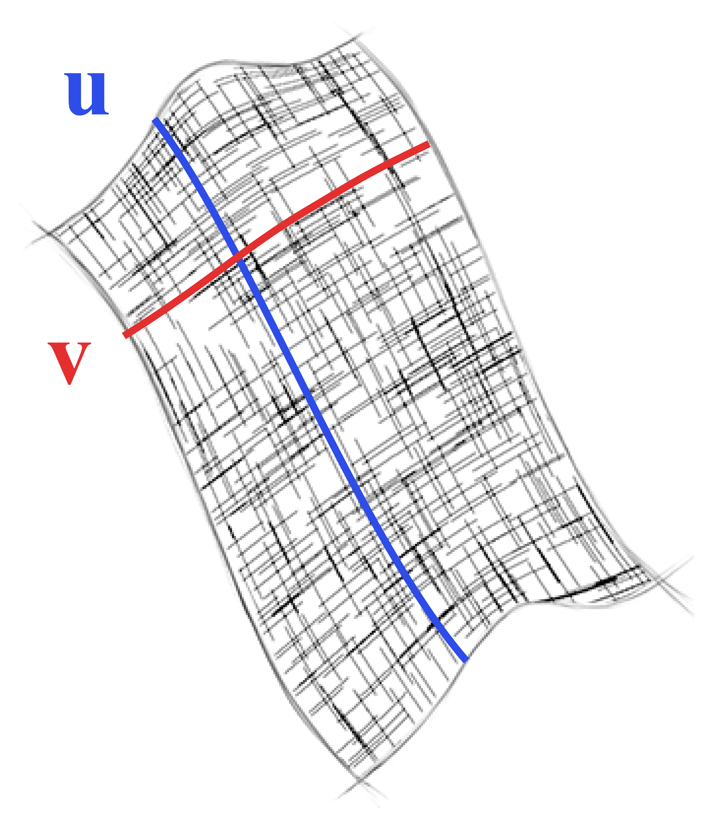
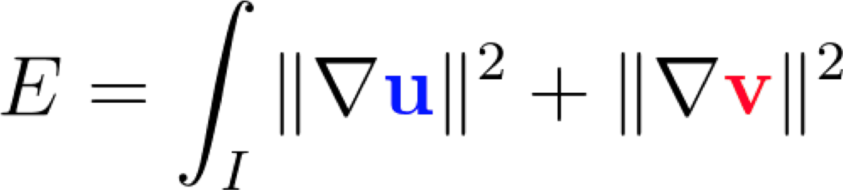
Our solution: smooth each direction along the other direction
Minimize gradient
Notes:
In equations, while the diffusion minimizes the gradient of both vector fiedls, our energy uses covariant derivatives to only minimize along the direction of the vector fields.

Slide 37
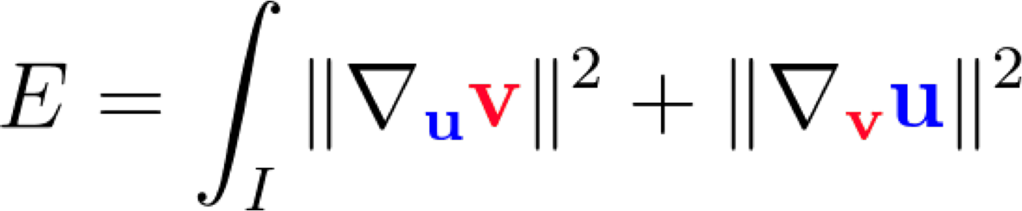
Our solution: smooth each direction along the other direction
Minimize gradient
Minimize covariant derivatives
Notes:
In equations, while the diffusion minimizes the gradient of both vector fiedls, our energy uses covariant derivatives to only minimize along the direction of the vector fields.

Slide 38
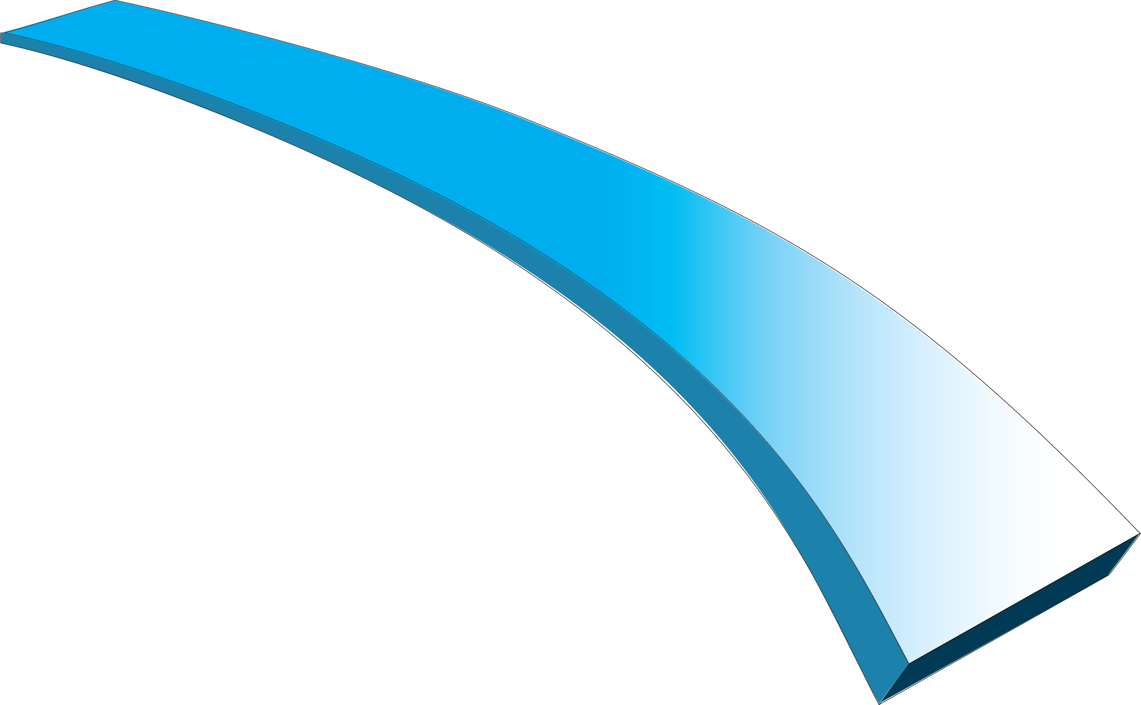
Our solution: smooth each direction along the other direction
Curvature lines have zero geodesic torsion
N
Darboux frame
V
U
Minimize covariant derivatives
Notes:
This intuitive explanaition has a link to geometry.
* Along curvature lines, the Darboux frame which is composed by two vector pointing in the orthogonal directions of curvature and its normal, should not rotate along V

Slide 39
Our solution: smooth each direction along the other direction
Curvature lines have zero geodesic torsion
N
Darboux frame
V
U
Minimize covariant derivatives
Notes:
This intuitive explanaition has a link to geometry.
* Along curvature lines, the Darboux frame which is composed by two vector pointing in the orthogonal directions of curvature and its normal, should not rotate along V

Slide 40
Our solution: smooth each direction along the other direction
Curvature lines have zero geodesic torsion
N
Darboux frame
V
U
Minimize covariant derivatives
Notes:
This intuitive explanaition has a link to geometry.
* Along curvature lines, the Darboux frame which is composed by two vector pointing in the orthogonal directions of curvature and its normal, should not rotate along V

Slide 41
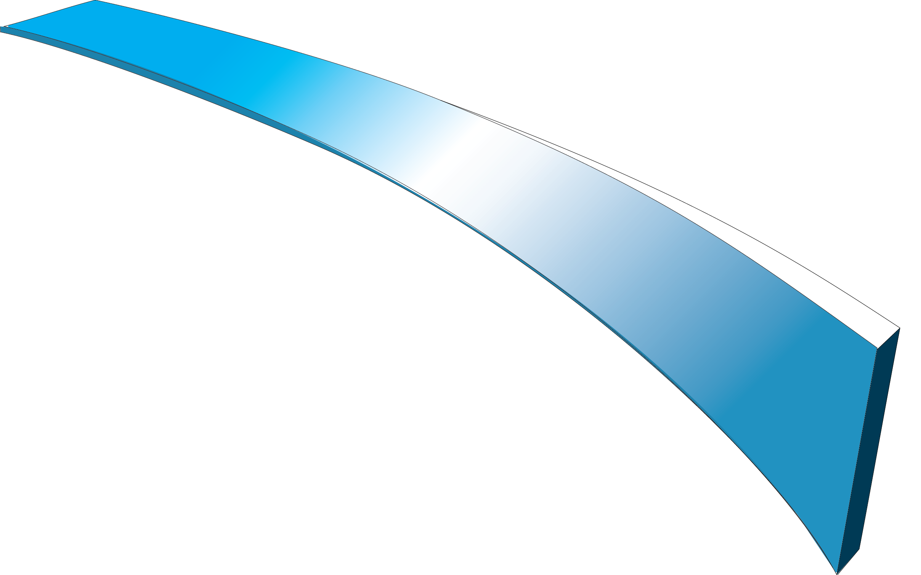
Our solution: smooth each direction along the other direction
Curvature lines have zero geodesic torsion
N
Darboux frame
V
U
Minimize covariant derivatives
Notes:
* To have this rotation would mean there is a direction in which the shape is more curvy, which contradicts the definition of curvature lines

Slide 42
Our solution: smooth each direction along the other direction
Curvature lines have zero geodesic torsion
N
Darboux frame
V
U
Minimize covariant derivatives
Notes:
* To have this rotation would mean there is a direction in which the shape is more curvy, which contradicts the definition of curvature lines

Slide 43
Our solution: smooth each direction along the other direction
Curvature lines have zero geodesic torsion
N
Darboux frame
V
U
Minimize covariant derivatives
Notes:
* To have this rotation would mean there is a direction in which the shape is more curvy, which contradicts the definition of curvature lines

Slide 44
Our solution: smooth each direction along the other direction
Curvature lines have zero geodesic torsion
N
Darboux frame
V
U
Higher curvature
Minimize covariant derivatives
Notes:
* To have this rotation would mean there is a direction in which the shape is more curvy, which contradicts the definition of curvature lines

Slide 45
Our solution: smooth each direction along the other direction
Curvature lines have zero geodesic torsion
N
Darboux frame
V
U
(See paper for full
derivation)
Minimize covariant derivatives
Notes:
This is why successive curvature lines tend to be parallel in a local
* See paper for full derivation

Slide 46
Our solution:
propagate curvature directions
Propagate in 2D
Lift to 3D
Input bitmap, local directions
2 directions at each pixel to form a cross field
Normal at each pixel from orthogonality constraint
Notes:
BYPASS
We propose to locally estimate 2D directions that we propagate in 2D to form a cross field.
Once we have crosses for each pixel, we can lift them to 3D by imposing orthogonality constraint

Slide 47
Our solution:
lift 2D directions to 3D
Propagate in 2D
Lift to 3D
Input bitmap, local directions
2 directions at each pixel to form a cross field
Normal at each pixel from orthogonality constraint
Notes:
BYPASS
We propose to locally estimate 2D directions that we propagate in 2D to form a cross field.
Once we have crosses for each pixel, we can lift them to 3D by imposing orthogonality constraint

Slide 48
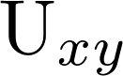
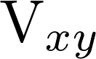


Lifting to 3D
Given and
Notes:
We only need to solve for the z values of the vectors, such that U dot V is 0 (because we know they are intended to be orthogonal in 3D). And also we want the resulting normal to be smooth along U and V, just like in the 2D version of this energy.

Slide 49

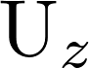
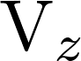




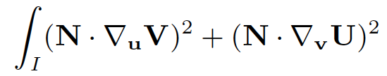
Lifting to 3D
Given and
Solve for and such that
-
- is smooth along and
Notes:
We only need to solve for the z values of the vectors, such that U dot V is 0 (because we know they are intended to be orthogonal in 3D). And also we want the resulting normal to be smooth along U and V, just like in the 2D version of this energy.

Slide 50
Main challenges
1
The BendFields smoothness energy
Non-orthogonal cross field
- Representation
- Optimization
2
-
Notes:
The 2 main challenges are to smoothly generate the cross field (that we call BendFields)
And the representation and optimization algorithm that we use for this task.

Slide 51
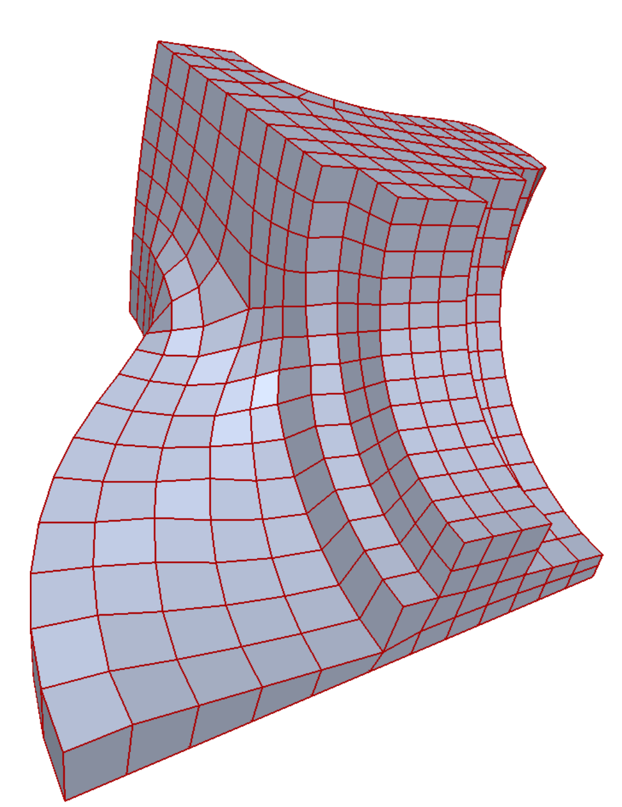
Existing crossfield representations
Orthogonal surface crossfield
[Ray et al. 2006, Bommes et al. 2009]
Notes:
Previous work in geometry processing make use of crossfields for applications like quad remeshing. These representations are usually orthogonal and a single vector is enough to represent the whole cross.
Additionally, since equivalent crosses can be defined differently, these representations also provide a mechanism called transition functions to compare these croses.

Slide 52
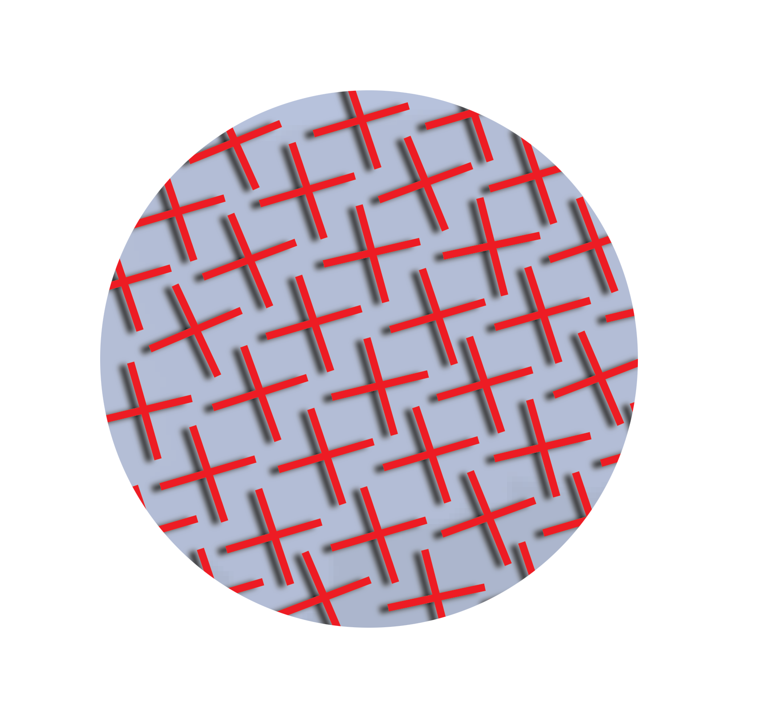
Existing crossfield representations
Orthogonal surface crossfield
[Ray et al. 2006, Bommes et al. 2009]
Notes:
Previous work in geometry processing make use of crossfields for applications like quad remeshing. These representations are usually orthogonal and a single vector is enough to represent the whole cross.
Additionally, since equivalent crosses can be defined differently, these representations also provide a mechanism called transition functions to compare these croses.

Slide 53
Existing crossfield representations
Orthogonal surface crossfield
[Ray et al. 2006, Bommes et al. 2009]
- The cross field is non-orthogonal
after projection
Notes:
"while a crossfield algined with curvature lines is orthogonal over the 3D surface, it is not orthogonal after projection in the image plane. We thus need a representation for non-orthogonal crossfields".

Slide 54
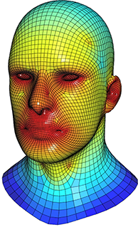
Existing crossfield representations
Orthogonal surface crossfield
[Ray et al. 2006, Bommes et al. 2009]
- The cross field is non-orthogonal
after projection
Frame fields, polyvector fields [Panozzo et al. 2014, Diamanti et al. 2014]
- Non-orthogonal
- Require constraints on both lines of the field
Notes:
CONCURRENTLY TO OUR WORK
More recently, non orthoganl representations have started to appear also por quad meshing applications, but they require to be constrained on 2 directions.
In our context, each line only constrains one direction

Slide 55
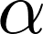
Our representation
An orthogonal cross with orientation
Notes:
Our representation is first based on an orthogonal cross defined with a ingle angle alfa

Slide 56
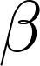
Our representation
An orthogonal cross with orientation
A deviation from orthogonality
Notes:
The, a second parameter beta defines a deviation from the orthogonality to complete the cross.

Slide 57

Constraint assignment
v
Each line can constrain one of 4 vectors
-u
u
-v

Slide 58
Constraint assignment
v
Each line can constrain one of 4 vectors
-u
u
-v
-u
v
u
-v

Slide 59
Constraint assignment
v
Each line can constrain one of 4 vectors
-u
u
-v
-u
v
u
-v
-u
v
u
-v

Slide 60
Constraint assignment
v
Each line can constrain one of 4 vectors
-u
u
-v
-u
v
u
-v
-u
v
u
-v
u
v
-v
-u

Slide 61
Constraint assignment
v
Each line can constrain one of 4 vectors
-u
u
-v
-u
v
u
-v
-u
v
u
-v
u
v
-v
-u
u
v
-v
-u

Slide 62
Constraint assignment
v
Each line can constrain one of 4 vectors
-u
u
-v
-u
v
u
-v
-u
v
Transition function [Ray et al. 2006]
u
-v
u
v
-v
-u
u
v
-v
-u

Slide 63
Constraint assignment
v
Each line can constrain one of 4 vectors
-u
u
-v
-u
v
Integer i
u
-v
α’ = α + i π/2
β‘ = (-1)^{i} β
-u
v
u
-v
α’ = α + i π/2
β‘ = (-1)^{i} β
u
v
-v
-u
u
α’ = α + i π/2
β‘ = (-1)^{i} β
v
-v
-u

Slide 64
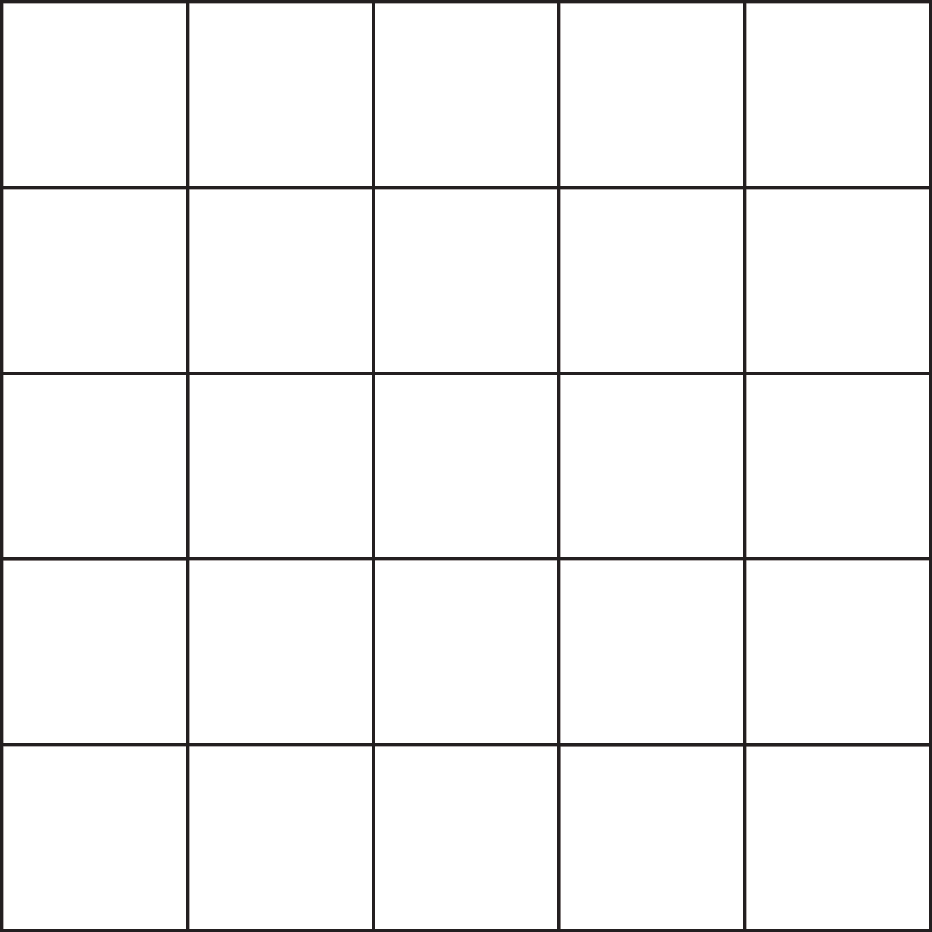
Algorithm
Input
- Regular grid (bitmap input)

Slide 65
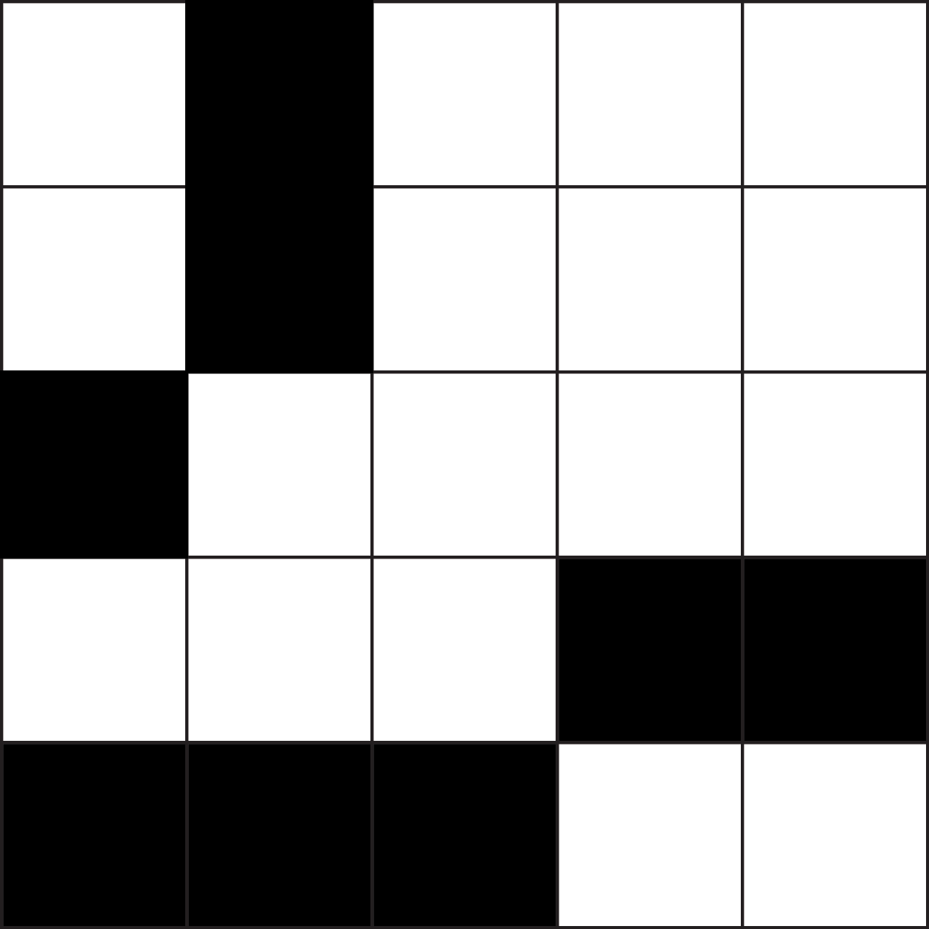
Algorithm
Input
- Regular grid (bitmap input)
- Input strokes

Slide 66
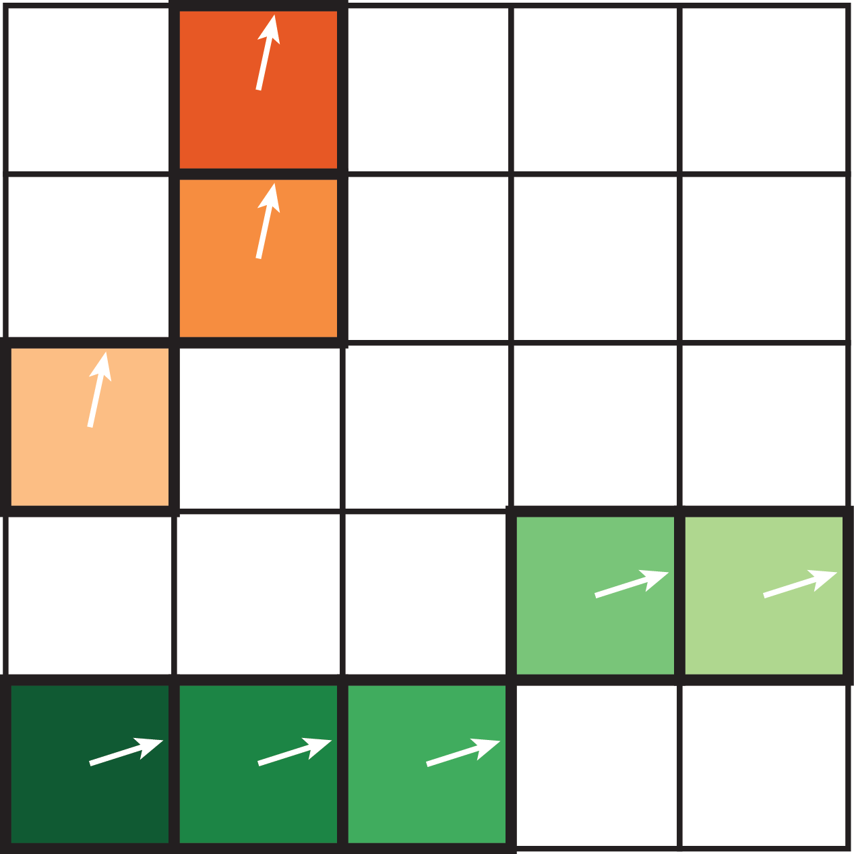
Algorithm
Constraints
- 1 direction per pixel

Slide 67
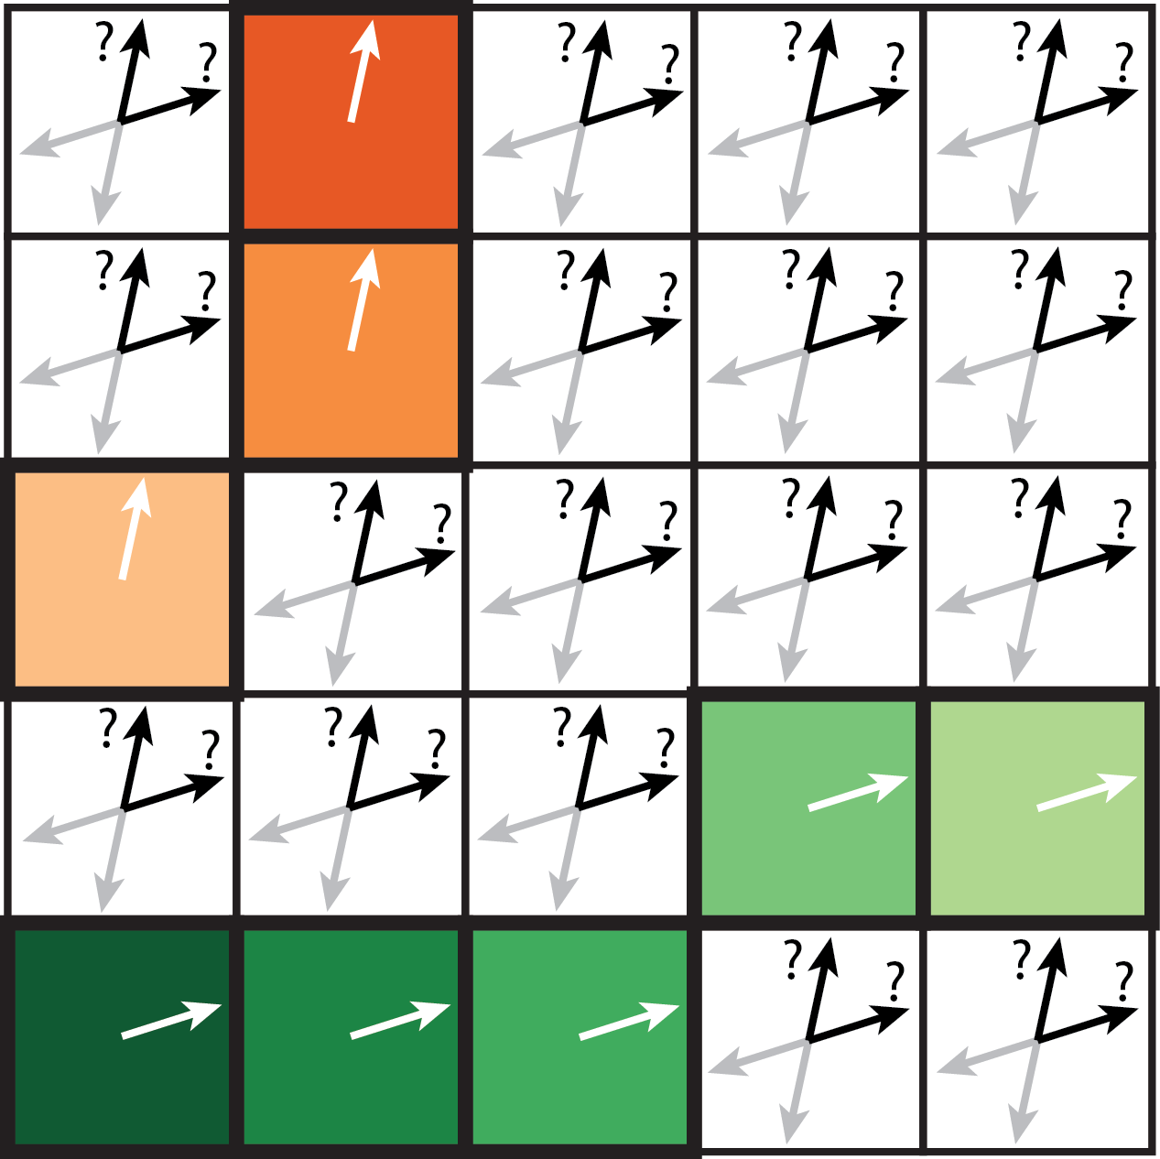
Algorithm
Unknowns
- 2 directions at each pixel

Slide 68
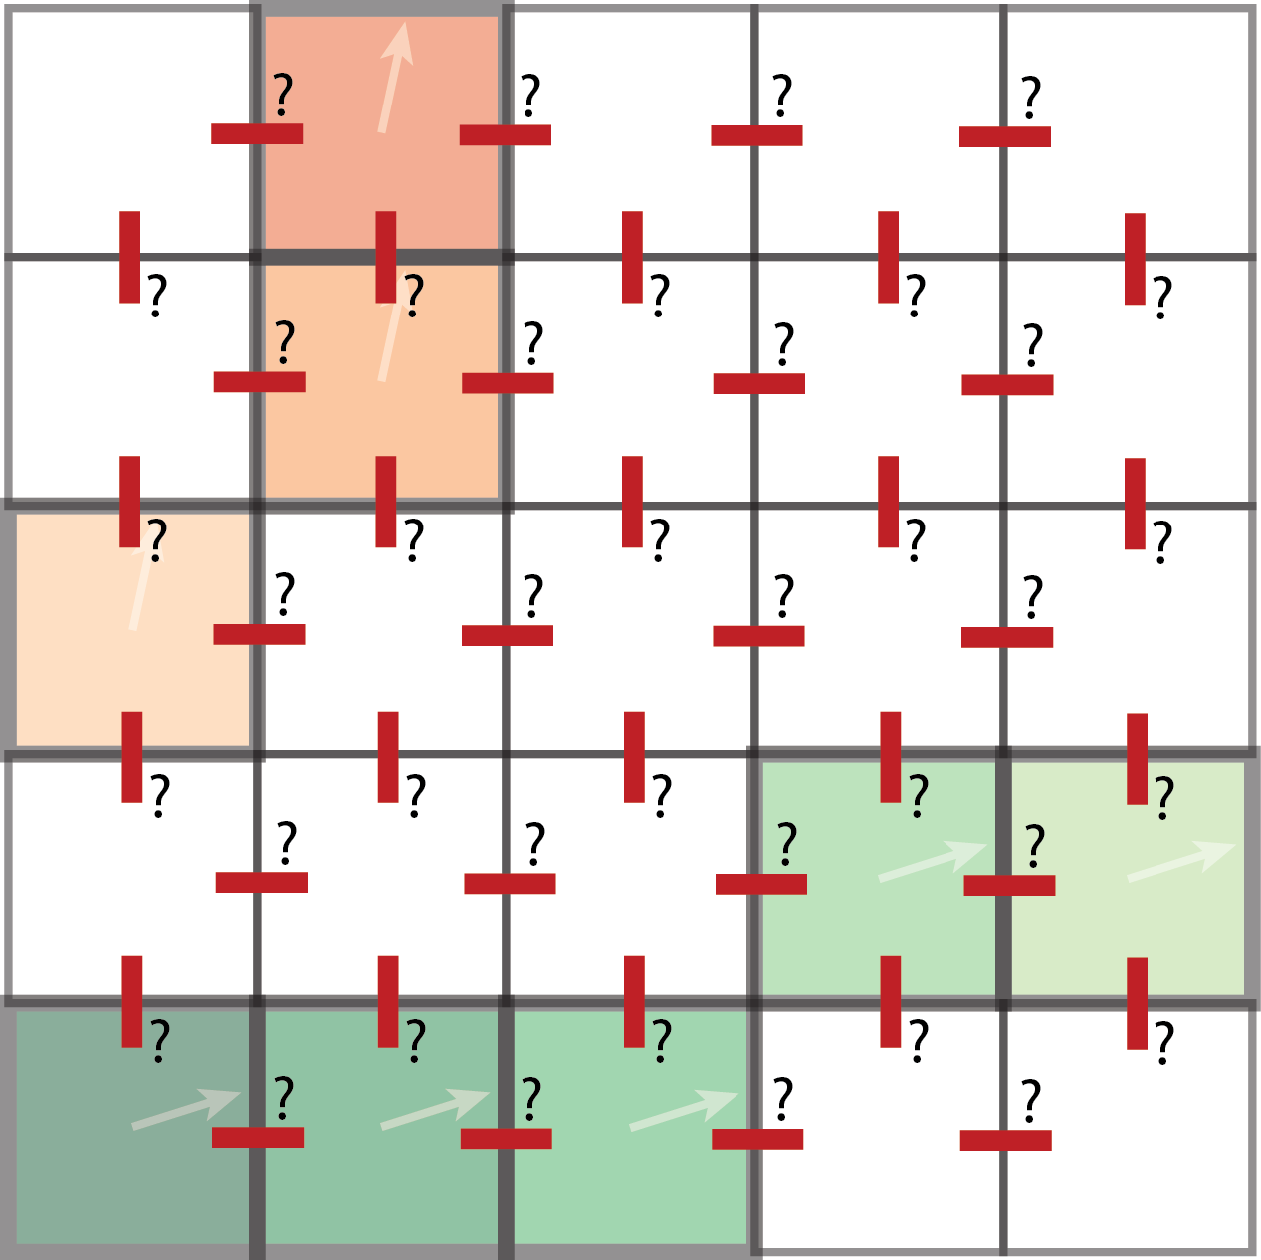
Algorithm
Unknowns
- 2 directions at each pixel
- 1 transition between
each pixel
α’ = α + i π/2
β‘ = (-1)^{i} β
Notes:
Unknown is integer

Slide 69
Algorithm
Initialization
- Assign orientation
Notes:
We adopt a greedy optimization. We initialize…

Slide 70

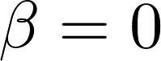
Algorithm
Initialization
- Assign orientation
- Assume orthogonal cross
Notes:
We adopt a greedy optimization. We initialize…

Slide 71
Algorithm
Initialization
- Assign orientation
- Assume orthogonal cross
- Propagate to nearest
neighbour
Notes:
We adopt a greedy optimization. We initialize…

Slide 72
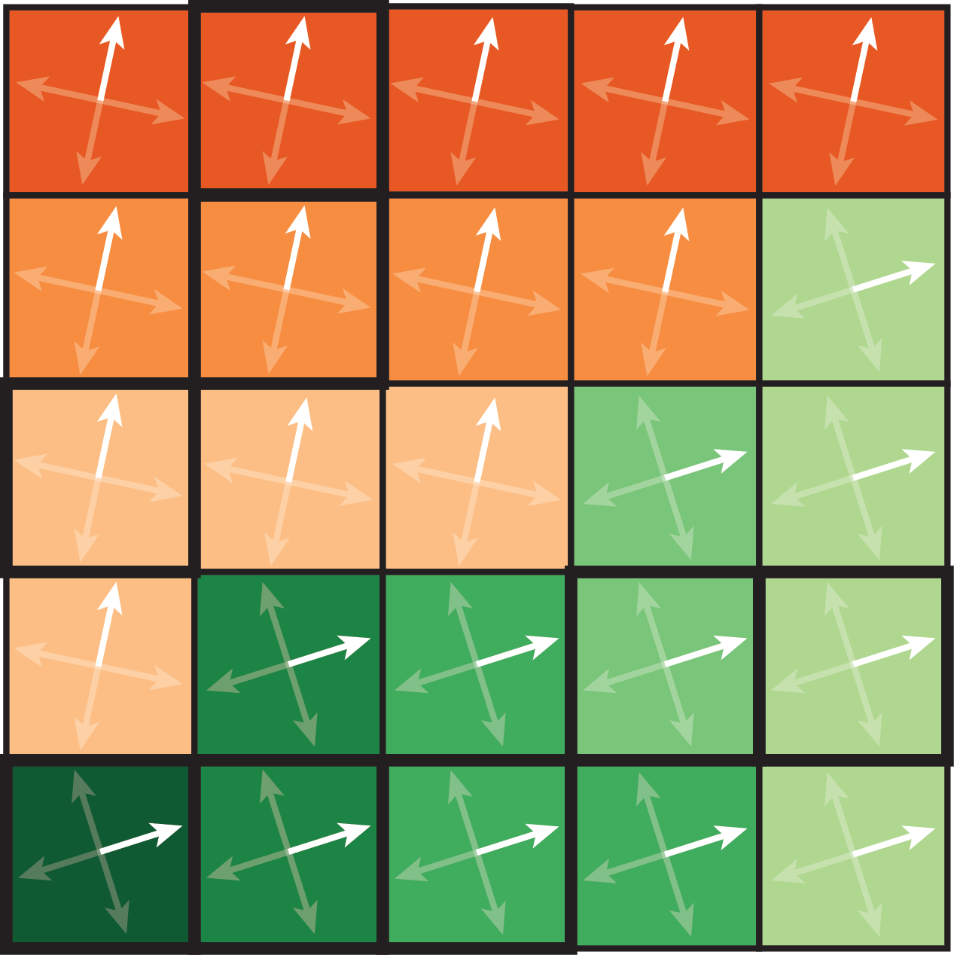
Algorithm
Initialization
- Assign orientation
- Assume orthogonal cross
- Propagate to nearest
neighbour

Slide 73
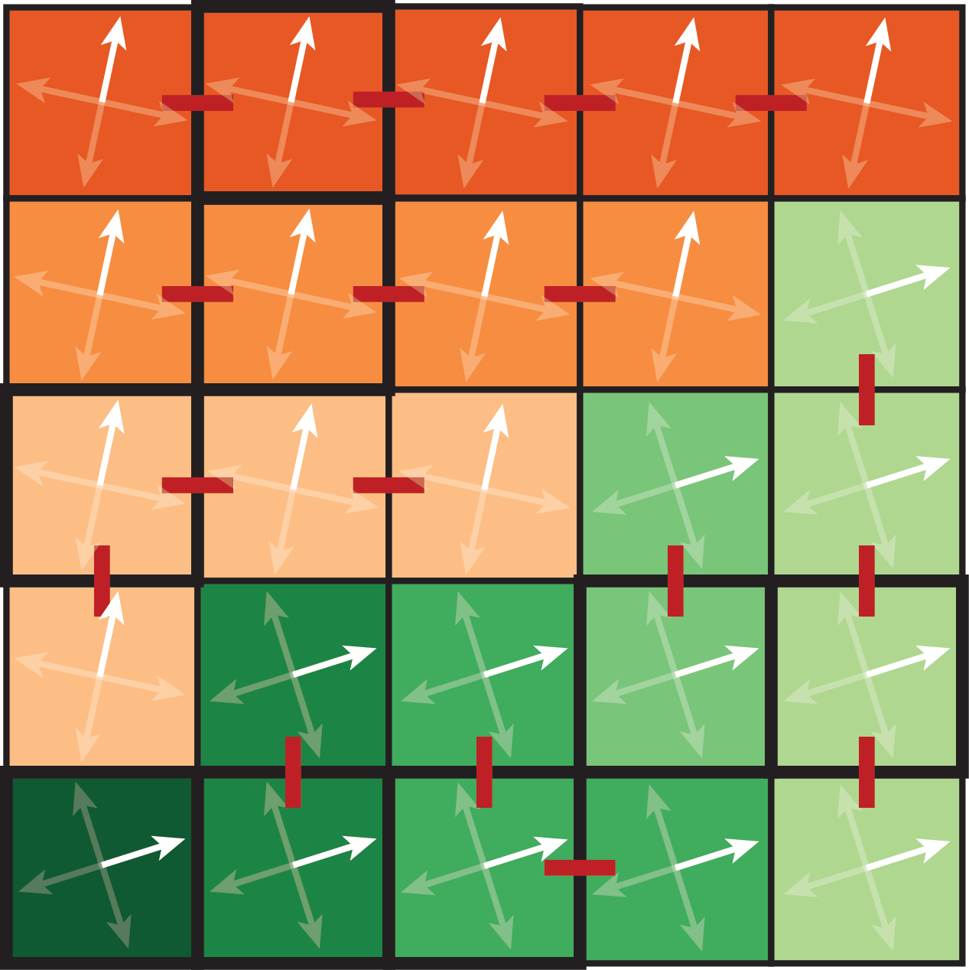
Algorithm
Initialization
- Fix transition to 0 along
shortest path

Slide 74
Algorithm
Greedy optimization:
- Select transition

Slide 75
Algorithm
Greedy optimization:
- Select transition
u
v
u
-v
v
-u
-u
-v

Slide 76
Optimization
Greedy optimization:
- Compute unknown i
α’ = α + i π/2
β‘ = (-1)^{i} β
u
v
u
-v
v
-u
-u
-v

Slide 77

Optimization
Greedy optimization:
- Update crosses according
to our smoothness energy

Slide 78
Optimization
Greedy optimization:
- Select transition

Slide 79
Optimization
Greedy optimization:
- Compute unknown i
α’ = α + i π/2
β‘ = (-1)^{i} β
u
v
v
-v
-u
u
-u
-v

Slide 80

Optimization
Greedy optimization:
- Update crosses according
to our smoothness energy

Slide 81
Optimization
Greedy optimization:
Iterative process:
- Fix transition
- Update crosses

Slide 82

Optimization
Greedy optimization:
Iterative process:
- Fix transition
- Update crosses

Slide 83










Results
Input sketch
Cross field
Normals
Shaded sketch

Slide 84








Results
Input sketch
Cross field
Normals
Shaded sketch

Slide 85


Comparison to CrossShade [Shao et al. 2012]
CrossShade normals
CrossShade
curves

Slide 86

Comparison to CrossShade [Shao et al. 2012]
CrossShade normals
Our normals
CrossShade
curves
Rasterized
CrossShade curves

Slide 87




Robustness to sketchiness

Slide 88


Robustness to sketchiness

Slide 89




Robustness to sketchiness

Slide 90




Robustness to sketchiness

Slide 91



Limitations
Costly optimization, far from real time (~30 minutes)
Potential for coarse-to-fine scheme (future work)

Slide 92

Conclusion
Estimate curvature and normal fields from rough bitmap sketches

Slide 93
Conclusion
Estimate curvature and normal fields from rough bitmap sketches
Non-orthogonal cross field representation and optimization
-

Slide 94

Conclusion
Estimate curvature and normal fields from rough bitmap sketches
Non-orthogonal cross field representation and optimization
Smoothness energy derived from properties of curvature lines
-

Slide 95
Conclusion
Estimate curvature and normal fields from rough bitmap sketches
Non-orthogonal cross field representation and optimization
Smoothness energy derived from properties of curvature lines
-
SOURCE CODE AVAILABLE ONLINE!

Slide 96



Future work
Toward 3D models from rough sketches
Notes:
Challenges that remain

Slide 97


Future work
Toward 3D models from rough sketches
Notes:
Challenges that remain

Slide 98
BendFields: Regularized Curvature Fields from Rough Concept Sketches
Emmanuel Iarussi¹ David Bommes^{1,2} Adrien Bousseau¹
ACM Transactions on Graphics
1
2

Slide 100

Ground Truth

Slide 101

Ground Truth

Slide 102

Singularities

Slide 103

Harmonic vs. BendFields energy

Slide 104

Harmonic vs. BendFields energy

Slide 105




Inverse order of operations
CrossShade [Shao et al. 2012]
Curves
Normals at each intersection
Propagation
Our solution
Directions
Propagation
Normal at each pixel

Slide 106


Automatic vectorization [Noris et al. 2013]
Rough sketches yield noisy curves
Input bitmap
Vector curves
Notes:
A first solution could be to vectorize the input, and the use crosshade approach to compute the normalfield.
However, state of the art methods in vectorization yield noisy curves.

Slide 107




Automatic vectorization [Noris et al. 2013]
Rough sketches yield noisy curves
Smoothing yields ambiguous junctions
Notes:
Smoothing improves the vectorization performace, but generates ambiguous junctions, which would require manual cleaning and desambiguation.
Precise JUNCTIONS are needed by crossshade

Slide 108

Limitations
Ambiguity between crossings and sharp turns

Slide 109
Limitations
Ambiguity between crossings and sharp turns

Slide 110
Limitations
Ambiguity between crossings and sharp turns

Slide 111

Limitations
Ambiguity between crossings and sharp turns

Slide 112

Limitations
Always favors crossing when cross deviates by less than 45° from orthogonality

Slide 113


Limitations
Always favors crossing when cross deviates by less than 45° from orthogonality

